Slide 1

Course Registration
Group- 2

Slide 2

Tech STacK:
JAVA
SPRING BOOT
JAVASCRIPT
CSS
HTML
MONGODB
REACT

Slide 3
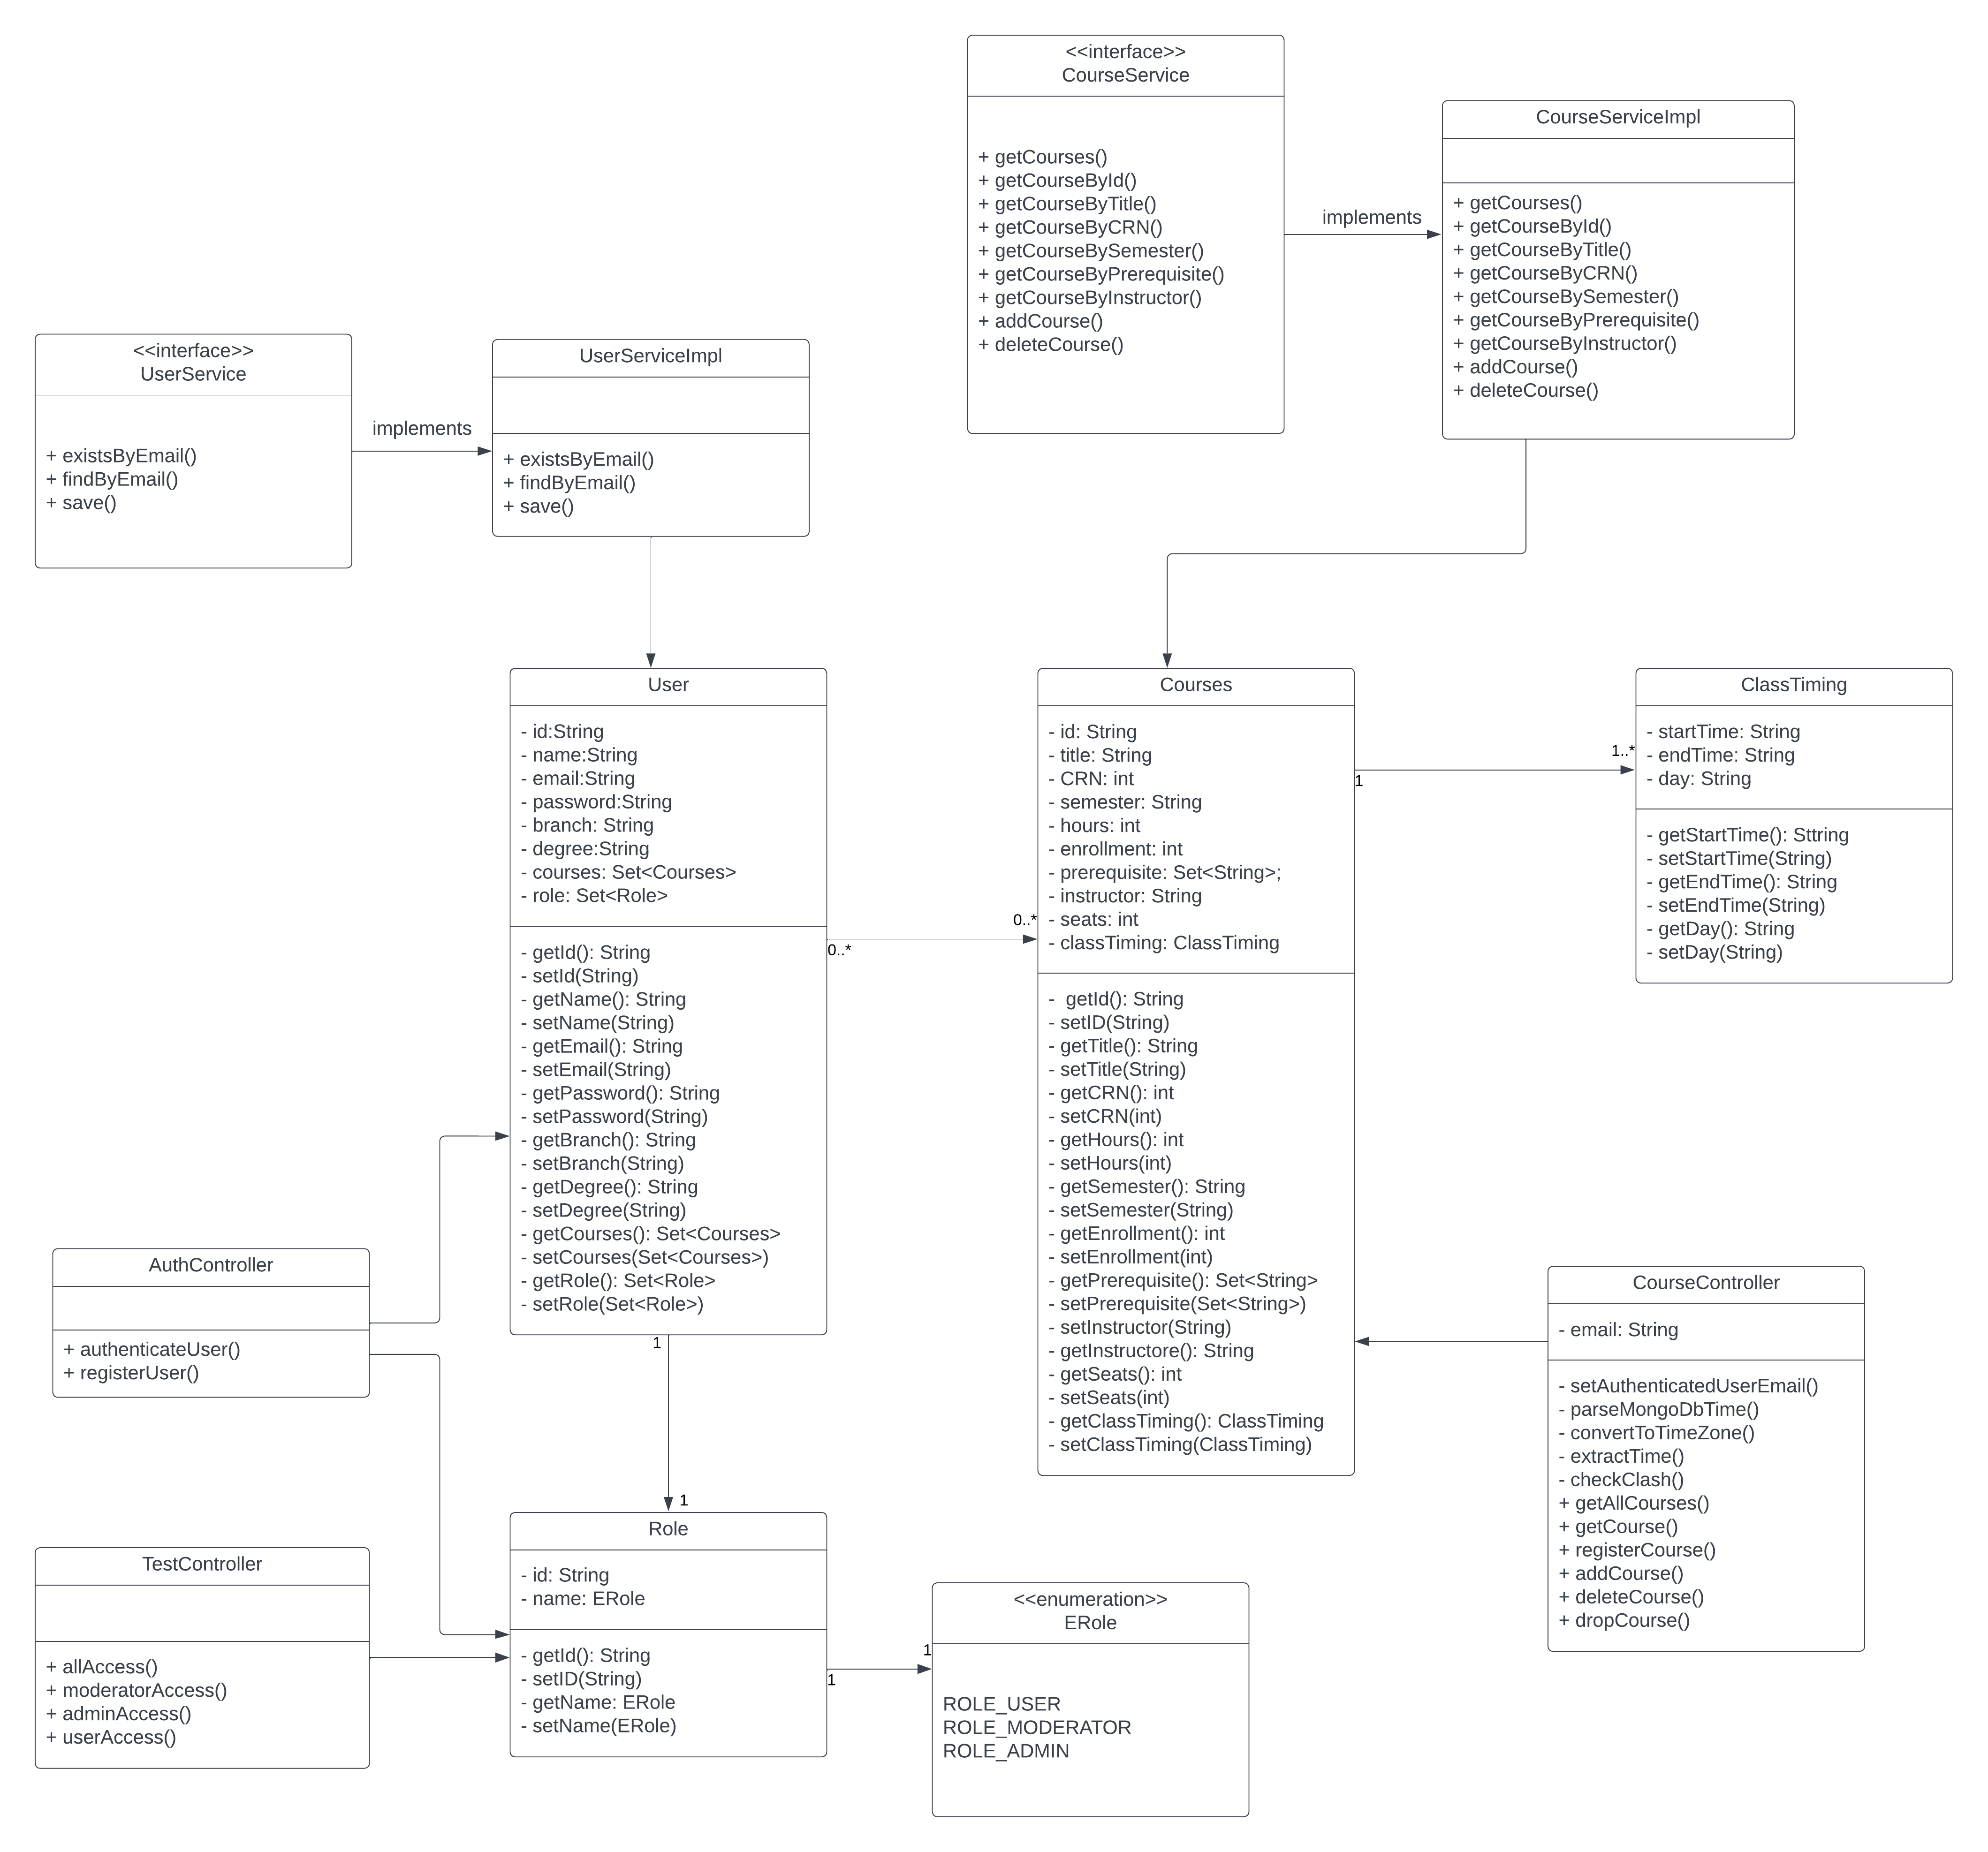
UML diagram

Slide 4
Functionalities
Sign in with existing credentials.
Sign up with a new account.
Use JWT tokens for secure and authenticated access.
Browse and search for available courses.
Access detailed information about each course, including description, schedule, instructor, and available seats.
Add courses to the user's schedule.
Drop courses if needed.

Slide 5
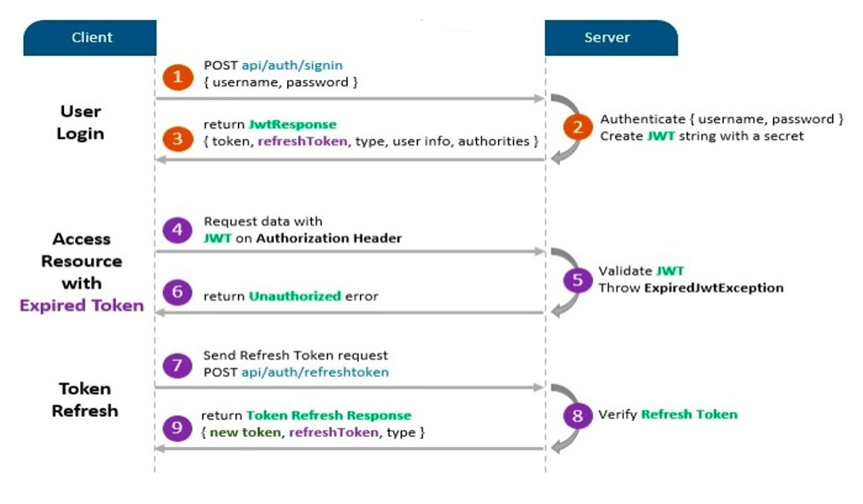
JWT WORKFLOW

Slide 6
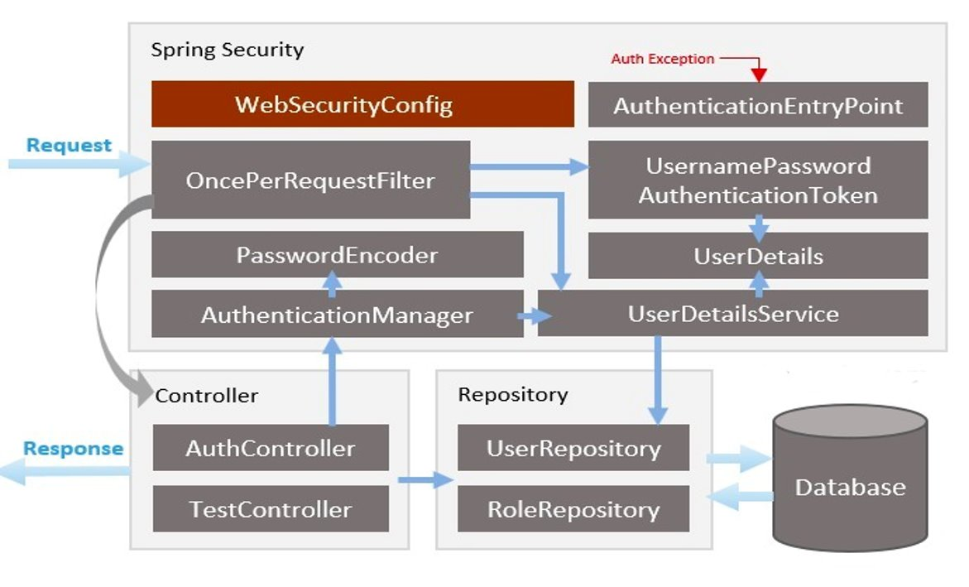
SPRING SECURITY WITH JWT

Slide 7
USE Cases:
Students should be able to browse available courses, view course details, and enroll in courses for upcoming semesters.
01
Allow students to drop courses.
03
Check whether there are conflicts or an excessive number of credit hours among courses in a semester.
02

Slide 8

FUTURE EnhaNcements:
Allow students to drop courses within specified deadlines without academic penalties and provide administrators with tools to handle cancellations.
Notify students about important registration dates, upcoming course openings, waitlist status changes, and other relevant information.
Assist students in planning their academic schedule by providing tools to search for courses, check schedule conflicts, and optimize their class timetable.
Generate reports on course enrollment trends, student demographics, and other key metrics to aid in academic planning and resource allocation.

Slide 9
Inheritance
Polymorphism
Abstraction
Encapsulation
Enum
collections
Lessons Learned from Class and Used In PRoject

Slide 10
lessons learned By Research and Used In Project
Springboot and mvc design pattern
Front End Development with react
Connecting to MongoDB from the backend and creating cluster in MongoDB Atlas

Slide 11
Individual contributions
Front-End
Jay – Course Tables ,Session & Error Handling
Anvitha – Admin Dashboard & routing
George – Navbar & Signout Logic
Lenin – Sigin & Sign up

Slide 12
INDUVIDUAL CONTRIBUTIONS
Backend
Shyam – Authentication with JWTs & Course Endpoints
Harshith – Admin Endpoints
Neha – User Endpoints
Ankur – Data Mangement
Lissa – Endpoint Response

Slide 13

Screenshots

Slide 14


Slide 15
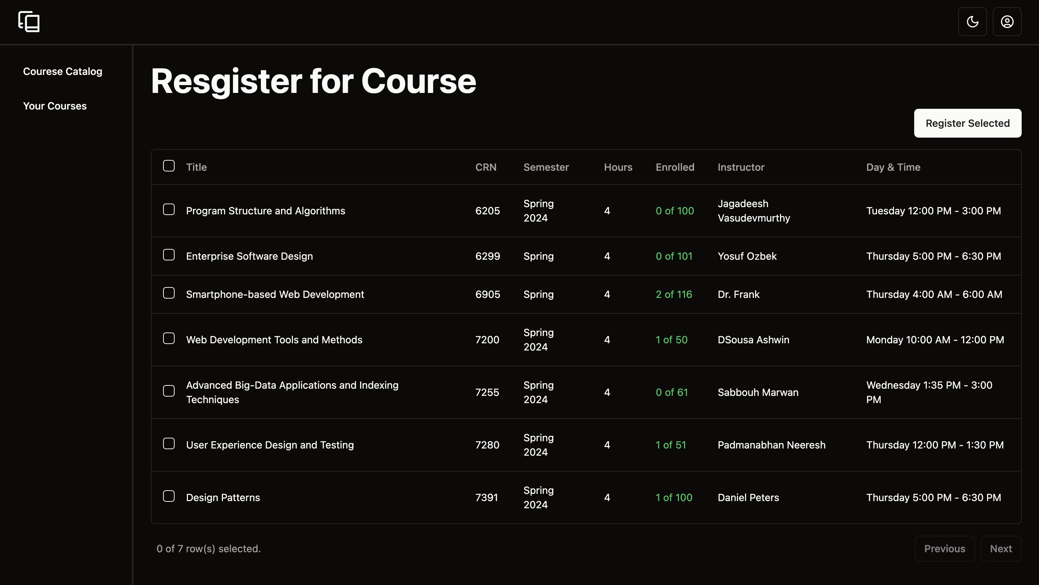

Slide 16
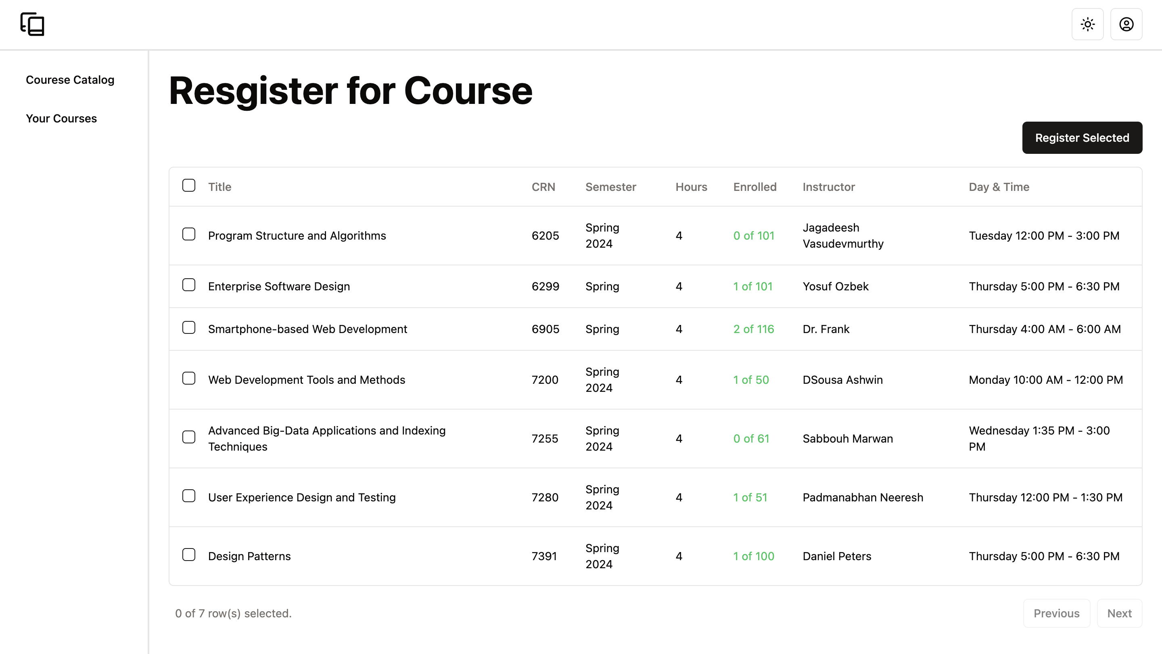

Slide 17
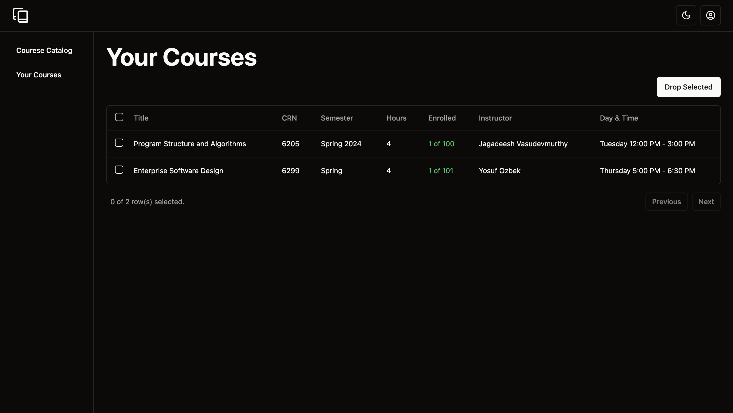

Slide 18
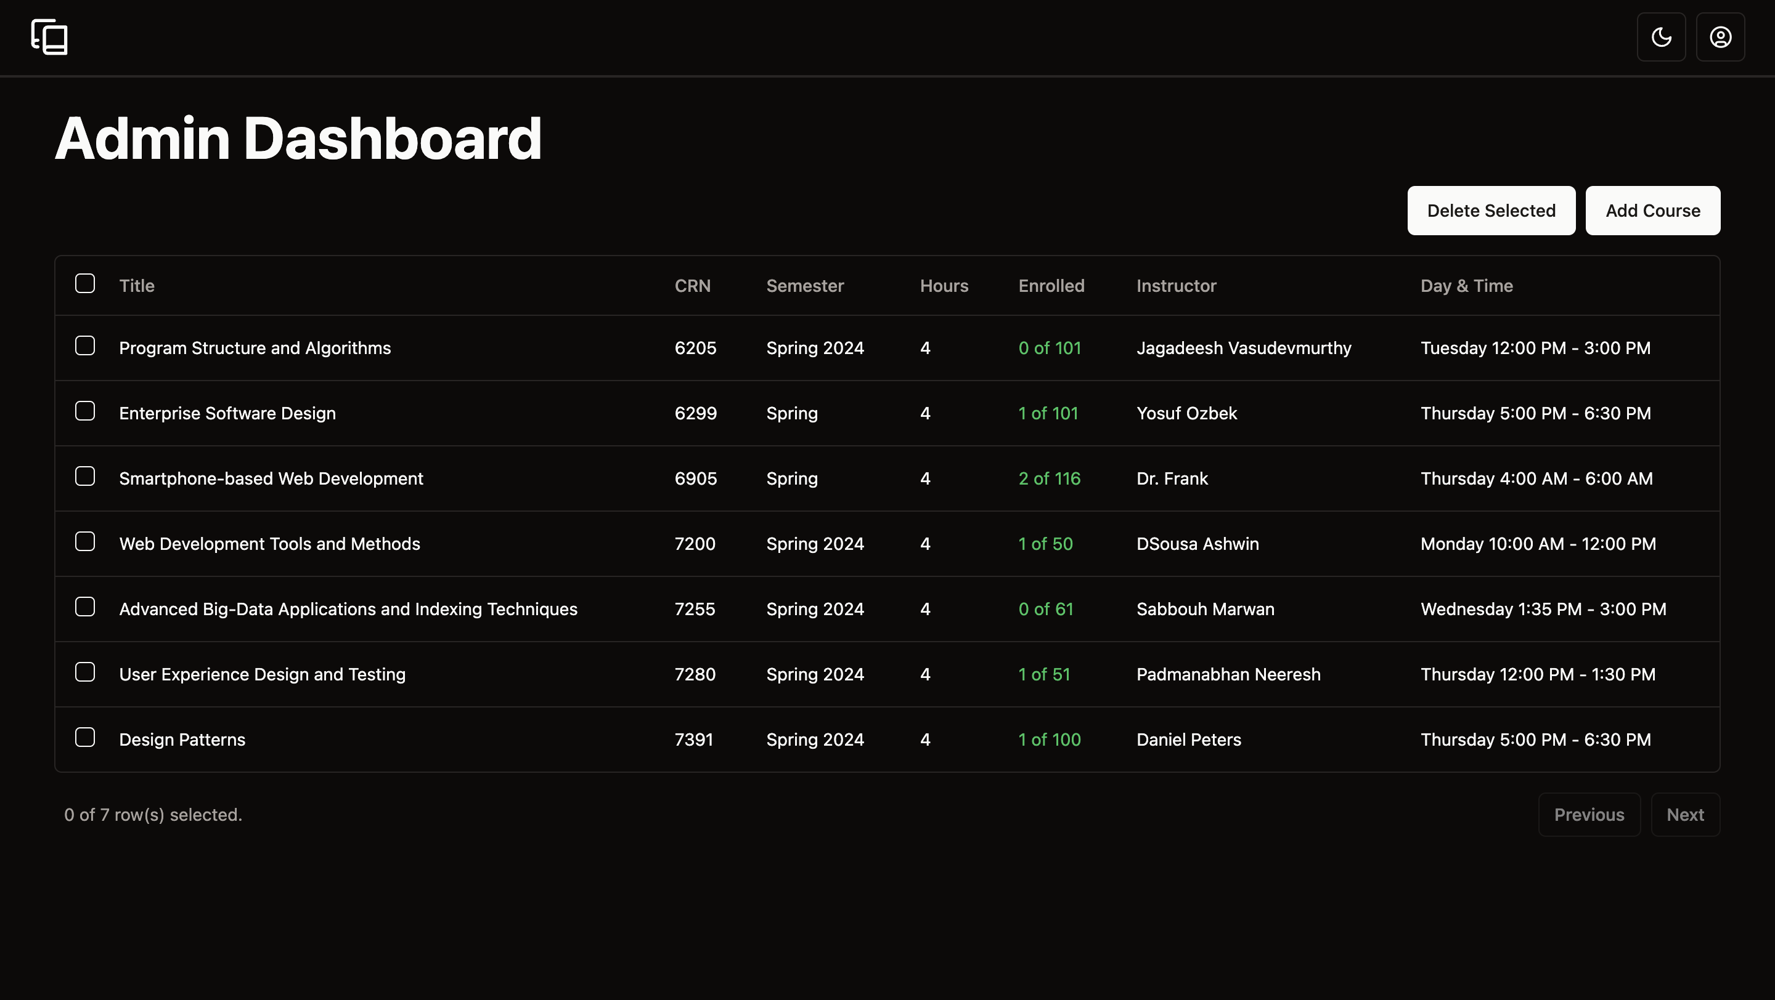

Slide 19
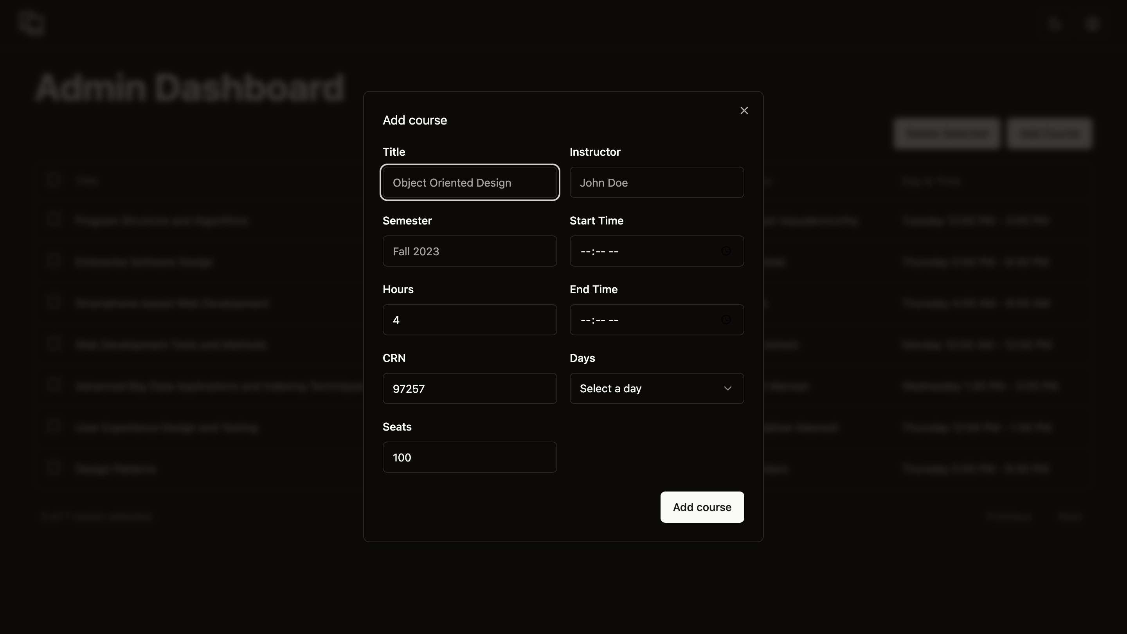

Slide 20
THANK YOU!

